Slide 1
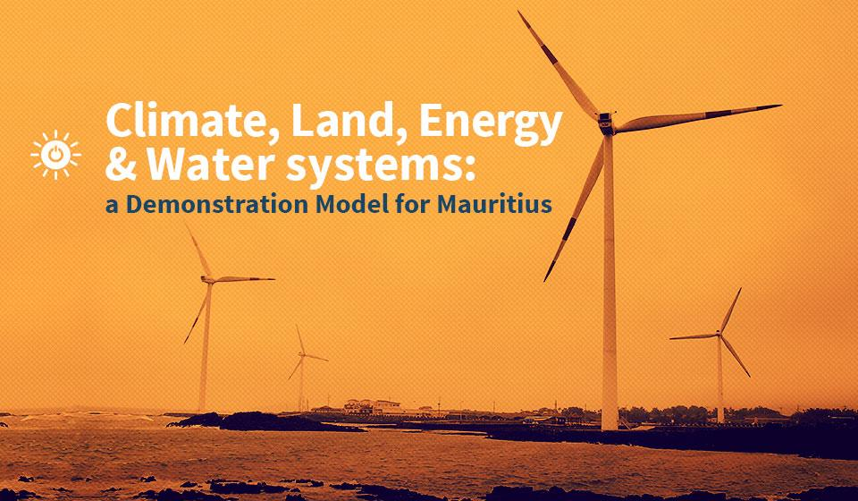

Slide 2
CLEWS Country Module
1. The food-energy-water nexus and sustainable development
2. The need for integrated planning: case studies
3. The CLEWS modelling approach
4. CLEWS case studies
5. Hands-on exercises with CLEWS

Slide 3
1. The food-energy-water nexus and sustainable development

Slide 4


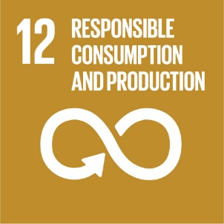



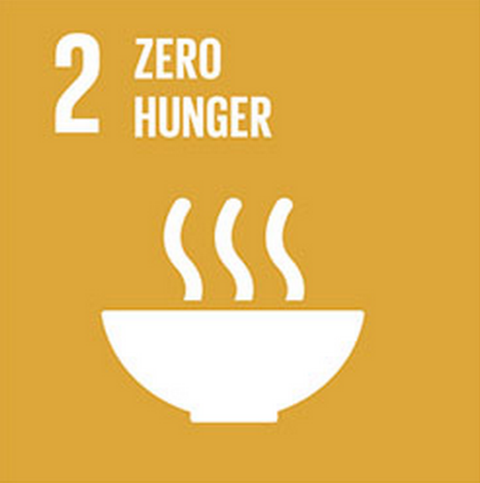






Sustainable development: food-energy-water nexus and CLEWS
Notes:
Direct, inner circle, and indirect, outer circle, links with the 2030 Agenda for Sustainable Development and the SDGs.
The objective is to illustrate the links among four components (water, land, energy and climate). They are featured in the SDGs, but beyond this, there are natural/structural interrelationships. There are also important indirect links to other issues.
The food-energy-water nexus directly relates to No Poverty (SDG 1), Zero Hunger (SDG 2), Clean Water and Sanitation (SDG 6), Life on Land (SDG 15), Renewable Energy (SDG 7) and Climate Action (SDG 13), among others.
The CLEWS framework can be used to assess the following issues:
i. The sustainability of infrastructure development (e.g., water and energy)
ii. Broader impacts of activities along production value chains
iii. How climate change impacts different sectors of the economy
Both food-energy-water nexus and CLEWS approaches can be employed in planning and capacity-building efforts.

Slide 5
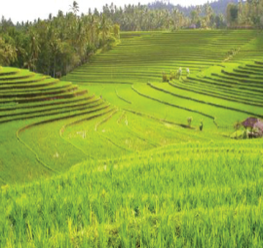
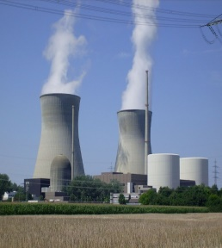
Undernourishment: 900 million people
108 countries with over 5% of people deprived
28 countries with over 20% of people deprived
No access to electricity: 1.1 billion people
50 countries with over 33% of people deprived
No modern fuels, cooking or heating: 3 billion people
No safe water: 900 million people
36 countries with over 20% of people deprived
No adequate sanitation: 2.6 billion people
66 countries with over 20% of people deprived
Risk of climate change, pollution, health and environment hazards
Risks higher where development needs are greater
Development challenges
Notes:
Note: this is a reference slide, not to be presented thoroughly, but to underscore underlying food-energy water nexus issues.
Highlight the global and national policy dimensions of global goals. Country figures show the range of deprivation in countries.
The bottom billion people in developing countries lack subsistence-level access to food, energy and water goods and services; the lower middle-income people find themselves spending increasingly larger proportions of their incomes to gain access; the upper-middle and high-income people overuse these resources with a substantial share wasted.
Meeting global development goals will entail significant challenges for many countries. These countries must exert particularly strong efforts to implement effective sustainable development policies
The University of Notre Dame has calculated indexes of exposure to climate change and correlated them with income. See: http://index.gain.org/.

Slide 6
Food and land
Sustainable land use
Productivity
Economic viability
Stability and resilience
Protection
Acceptable and equitable
Development challenges
Sustainable agriculture and food supply
Efficient use of water/fertilizer
Adapting to climate change
Urbanization
Food versus fuel
Environmental concerns
Incursion into natural ecosystems (biodiversity)
Greenhouse gas emissions (e.g., deforestation)
Land degradation from unsustainable agricultural practices
Waste
Notes:
Agriculture and food systems face enormous challenges—feeding a world population of 9 billion to 10 billion, making more efficient use of water and fertilizers, and adapting to climate change.
Land-use changes have allowed civilizations to grow crops, feed livestock, obtain energy, build cities and carry out a wide range of other activities key to economic growth and human development. However, they also profoundly alter ecosystems. The human footprint has affected 83% of the global terrestrial land surface and has degraded about 60% of ecosystem services. In the past 50 years alone, 12% of the global land surface has been converted to cropland, approaching the 15% threshold “planetary boundary” proposed under the planetary boundary” concept. (See Rockström et al. (2009). “A safe operating space for humanity.” Nature 461: 472-475.)
Establishment of protected areas is a key means to safeguard habitats and promote biodiversity. Protected area increased by 38% from 1992 to 2010, and global net loss in forest area declined from 7.3 million hectares per year in the 1990s to 3.3 million hectares per year from 2010 to 2015. Biodiversity loss is still high, because it is naturally developed over long periods of time. Measures can therefore take a long time before they yield benefits.
Sustainable land management:
Maintain and enhance production (productivity)
Reduce the level of production risk (stability/resilience)
Protect natural resources (protection)
Be economically viable (viability)
Be socially acceptable (acceptability/equity)

Slide 7
Water
Development challenges
Population growth, economic growth, urbanization
Provide sufficient water to feed a growing population
Provide safe drinking water and sanitation to all
More efficient use of water resources
Protect groundwater resources
Environmental concerns
Climate change (droughts/floods/sea level rise)
Pollution, eutrophication
Sustainable water management
Water quantity
Ecosystems
Water quality
Notes:
How we manage water is fast becoming an urgent political issue.
Growing pressure on water resources—from population and economic growth, climate change, pollution and other challenges—has major impacts on our social, economic and environmental well-being. Many of our most important aquifers are being overpumped, causing widespread declines in groundwater levels. Quality is declining, threatening the health of people and ecosystems, and increasing the cost of treatment. Some 900 million people around the globe still lack access to clean water, and thousands perish daily for lack of it.
At the same time, population growth and dietary changes mean that a dramatic increase in food production is necessary. Yet increasing water security challenges facing agriculture have been a significant contributor to food price volatility. The symptoms of this problem can be seen in three related areas: global food and commodity prices, the changing volumes of trade and price trends for other food and agricultural commodities, and knock-on effects in other markets for various crops and foodstuffs, which in and of themselves are not necessarily water stressed
About 40% of water used in irrigation is wasted through practices such as field flooding. Efficient irrigation systems, however, can be combined with crop protection and crop enhancement products to save water and increase productivity. Modern herbicides allow no-till and minimal tillage so ploughing isn’t necessary and soil structure is preserved. As a result, soil is able to receive and retain water more effectively and reduce runoff.

Slide 8
Energy
Development challenges
Access to sustainable energy for all
Support industrial development
Energy for the needs of the 21st century
Efficient use of land and water
Environmental concerns
Greenhouse gas emissions
Mining (mountain top removal, other)
Environmental emissions (NOx, SOx, lead, particulates)
Indoor air pollution
Solid and liquid wastes, radioactive waste
Sustainable energy
Universal access
Safe, reliable, affordable
Clean
Notes:
This illustrates some of the trade-offs in energy use.
* There is an increasing need to provide access to cleaner forms of energy.
Reliability of supply and affordability are also important factors to consider.
With increasing demand, countries need to plan effectively to manage their energy resources to generate electricity. Loss of supply is very expensive, and people start using more and more stand-alone diesel generators to compensate.

Slide 9
Sustainable development: food-energy-water nexus
Highly interlinked systems
Often referred to as the nexus
National sustainable development policies
Land (food)
Water
Energy
Notes:
A diagram of the food, energy and water nexus illustrates multiple interconnections.

Slide 10

Interlinkages: water use for agriculture
Production of food accounts for the largest component of the human water footprint.
About 70% of freshwater withdrawals worldwide are for agriculture
Can be as high as 90% in some low-income countries
Lower in most higher income countries
National sustainable development policies
Food
Water
Energy
Notes:
When efficient irrigation is combined with steps for increased productivity and water efficiency, farmers produce more food and become better stewards of their land. There is greater protection against rain runoff, soil erosion, water or heat stress on plants, flooding and desertification. Policy reform (water pricing, water rights, subsidies, etc.) and technology are vital. Free or underpriced inputs lead to wasteful practices.

Slide 11

Interlinkages: water for energy supply
Approximately 20% of freshwater withdrawals are for industrial purposes
National sustainable development policies
Land (food)
Water
Energy
Cooling thermal processes in the power and manufacturing sectors
Primary fuel extraction
Fuel refining and conversion
Emissions control
Biofuel/biomass production
Notes:
Water is important in the energy sector:
Used for cooling in thermal and nuclear power plants
Used (not consumed) in hydropower plants
Heavily used for fuel extraction and refining
Emissions control technology
Growing fuel crops like jatropha, sugarcane, etc.

Slide 12
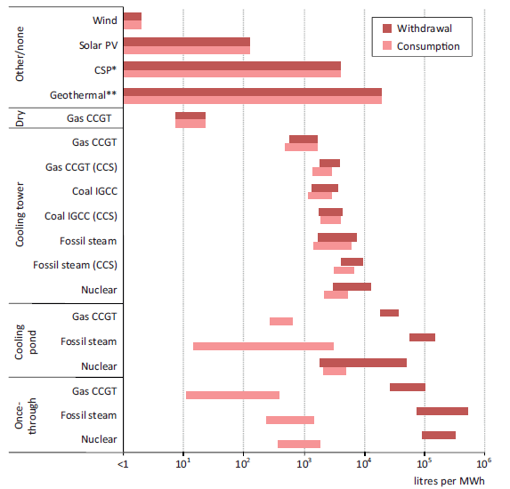
Interlinkages: water for electricity generation
National sustainable development policies
Land (food)
Water
Energy
Notes:
Explain the difference between water withdrawal and consumption.
Explain the change in unit on the x-axis.

Slide 13
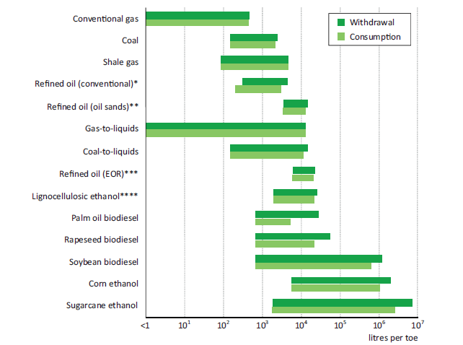
Interlinkages: water for energy
resource extraction, refining and fuel production
National sustainable development policies
Land (food)
Water
Energy
Notes:
Explain the difference between water withdrawal and consumption.
Explain the change in unit on the x-axis.

Slide 14
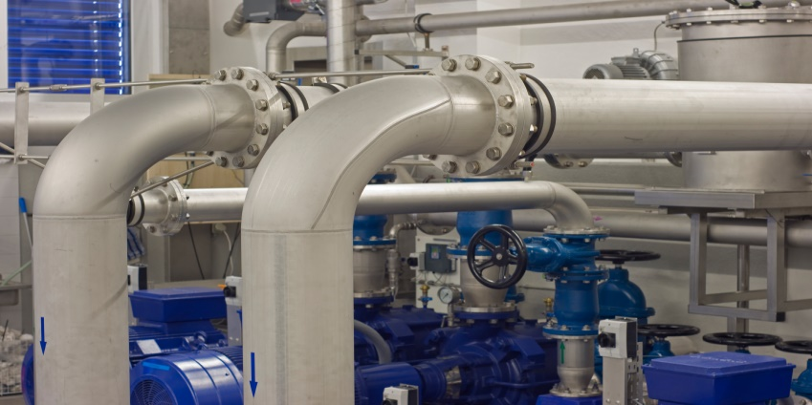
Interlinkages: energy for water supply
The water supply chain is energy intensive (around 7% of global electricity use)
Supply:
Surface water: 0-2,400 kWh per million litres for transportation depending on distance and change in elevation
Groundwater: Varies with depth (e.g., 140 kWh per million litres at 35 metres and 530 kWh per million litres at 120 metres)
Treatment:
26 kWh per million litres for high-quality groundwater
300-1400 kWh per million litres for brackish groundwater desalination
3,600-4,500 kwh per million litres for seawater desalination
Distribution:
Average of 290 kWh per million litres, but varies widely depending on distance and change in elevation
National Sustainable development policies
Land (food)
Water
Energy
Notes:
Water needs to be brought from the source to where it is needed. While some water supply systems are gravity driven, many need pumping to bring the water to consumption centres. The amount of energy required will vary widely from system to system, mainly determined by distances the water needs to be conveyed and topography. For groundwater, the energy requirement is directly related to the depth of the water table. As the water table drops, the amount of energy needed to lift water to the surface increases accordingly.
The treatment of water (before and after consumption) is dependent on treatment technology, the quality of the water source, and the desired quality of water for consumption.
Distribution from treatment facilities to the end-user also requires pumping.
As water demand increases and we need to access lower quality sources, such as seawater or brackish water, supplying water becomes more energy intensive. Technological improvements are making treatment more energy efficient, however. With the world population congregating in cities, the demand for water will become increasingly concentrated and intensify the need for water transportation
Sources: Cambridge Energy Research Associates, Natural Resources Defense Council and Pacific Institute (2004) “Energy down the drain: The hidden costs of California’s water supply.” US Department of Energy (2006). “Energy Demand on Water Resources: Report to Congress on the Interdependence of Energy and Water.” Electric Power Research Institute (2000). “Water and sustainability: US electricity consumption for water supply and treatment—The next half century.”

Slide 15

Interlinkages: land use for energy
A growing share of land is dedicated to supplying energy
Bioenergy accounts for a little more than 10% (60 EJ) of the world’s total primary energy supply
On average 11% of coarse grains, 11% of oil seeds and 21% of sugarcane were used for biofuel production from 2008 to 2010
495 TWh of electricity was produced from biomass in 2014 or 2% of world electricity generation
National sustainable development policies
Land (food)
Water
Energy
Notes:
The importance of land for energy:
Growing crops for producing biofuel is leaving a big footprint on land use.
Land use is an important factor in large-scale photovoltaic power plants and wind turbines.
There are some innovative ways to increase efficiency in the use of land for solar energy, such as by placing the panels on top of canals and on land with scattered vegetation.

Slide 16
Interlinkages: land use for energy
National sustainable development policies
Food
Water
Energy
Source: V. Fthenakis and H. C. Kim (2008). “Land use and electricity generation: A life-cycle analysis.” Renewable and sustainable energy reviews.
Notes:
Different technologies have widely different land footprints (note the break in the y-axis).
This chart shows land transformation; land occupation would rank technologies differently.

Slide 17
Interlinkages: land use for energy Selected biotechnologies
National sustainable development policies
Land (food)
Water
Energy
Source: International Energy Agency (2011). “Technology Roadmap—Biofuels for Transport.”
Notes:
Examples of the ranges of land use for bioenergy sources.

Slide 18
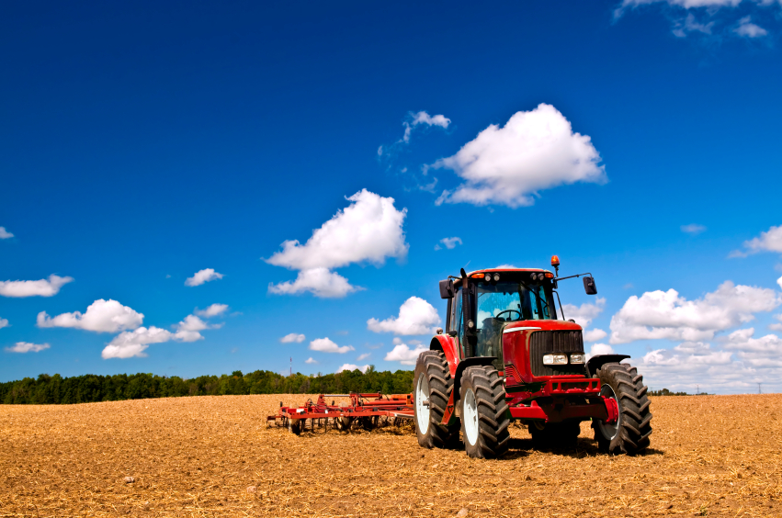
Interlinkages: energy for agriculture and food
Energy is required to power agricultural machinery for field preparation, crop harvesting, drying and processing
Direct energy use accounts for roughly 2.1% of total final energy demand
Energy is required to produce fertilizers, pesticides and other agricultural inputs
Indirect energy use in agriculture is about 1.2% of total final energy demand
In addition, energy is needed to process, transport, store, package and market food and food products
National sustainable development policies
Land (food)
Water
Energy
Notes:
Energy, primarily electricity and fossil fuels, is vital for agriculture. It is actually used throughout the life cycle of crops: from transportation of seeds to the farm, all the way to transporting agricultural products to markets for consumption.

Slide 19
Concluding remarks
There are strong interlinkages among food production, land use, energy and water.
Policy decision-making needs to take these interlinkages into account.
An integrated approach that simultaneously takes them into account is advisable.
Integrated narratives are useful, but numbers are needed, suggesting the use of quantitative models.

